Slide 1

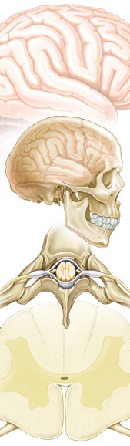
V.N.Karazin Kharkiv National University
Department of Neurosurgery
Cerebrovascular Diseases
neurohirurg.umi.ru

Slide 2
◊ Annually there are more than 7 million cases of strokes registered all over the world
◊ 4,6 million of people die each year, that is 9-12% from all death rate (WHO)
◊ Cerebrovascular disease is the most common life threatening neurological event in the U.S. Intracranial atherosclerosis is responsible for approximately 40,000 of these attacks per year, representing 10% of all ischemic strokes
◊ During the last 15 years cerebrovascular pathology among the people able to work has grown almost twice and to 2025 year the cerebro-vascular diseases rate will be increased on 30%

Slide 3
◊ Stroke is the third leading cause of death in the United States. Of the more than 700,000 people affected every year, about 500,000 of these are first attacks, and 200,000 are recurrent. About 25% of people who recover from their first stroke will have another stroke within five years
◊ Stroke is a leading cause of serious long-term disability, with an estimated 5.4 million stroke survivors currently alive today. The American Heart Association estimates that in 2003, stroke cost about $51.2 billion in both direct and indirect costs in the United States alone
◊ The most recent prevalence statistics from the American Heart Association estimate that 5,400,000 people have experienced stroke
◊ Every year, an estimated 30,000 people in the U.S. experience a ruptured cerebral aneurysm and as many as 6% may have an unruptured aneurysm
◊ Arteriovenous malformations (AVMs) are present in about 1% of the general population. The risk of hemorrhage from an AVM is 4% percent per year with a 15% chance of stroke or death with each hemorrhage

Slide 4
◊cerebral circulation regulates metabolic activity of brain tissue
◊brain practically does not keep reserves of oxygen
◊brain mass of approx 1400 gr. (2% of body’s); it consumes approximately 20% of all oxygen and 17% of all glucose which incomes the organism
◊ total area of brain capillaries in adult ~ 12 m², total length is about 650 km
Features of cerebral blood flow

Slide 5
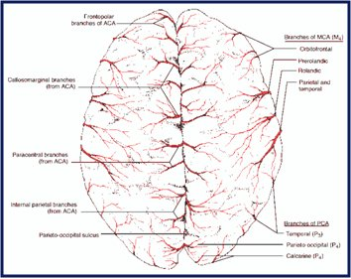
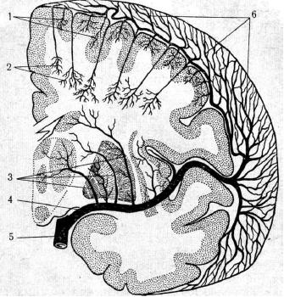
Cerebral arteries and their branches are formed by two systems, on which blood flows into cerebrum:
◊ arterial system on the convex of the brain
◊ arteries inside the brain of both systems
Anatomy-topographical features of cerebral vessels
The vascular system of brainstem is presented by arteries, which depart from the vessels of brain basis and has plenty of anastomosis

Slide 6
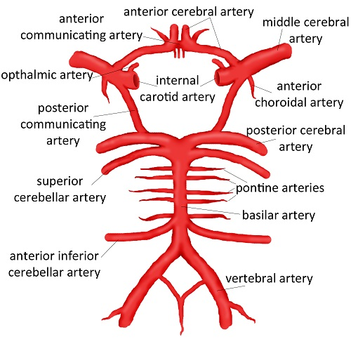
Collateral Circulation
- Circle of Willis
- Variation
- Leptomeningeal Collateral
A circle of Willis is a basic level of anastomosis

Slide 7
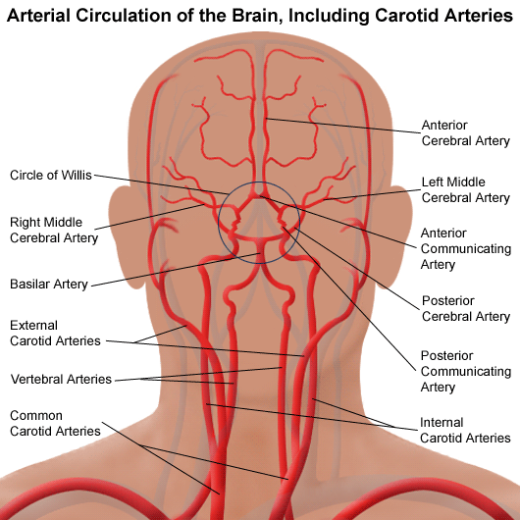
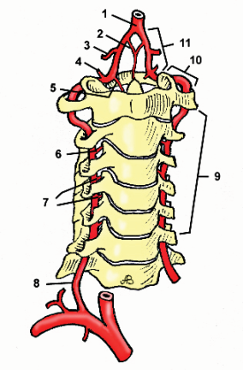
Location VA

Slide 8
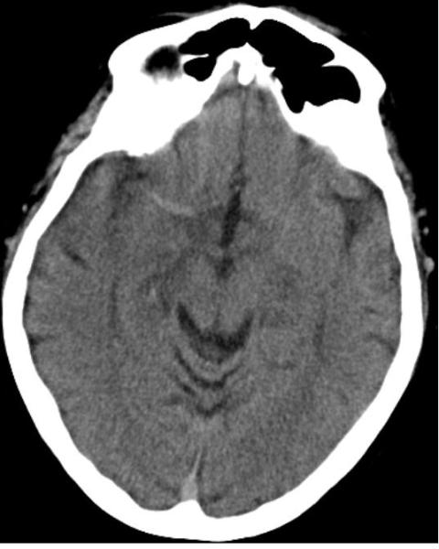
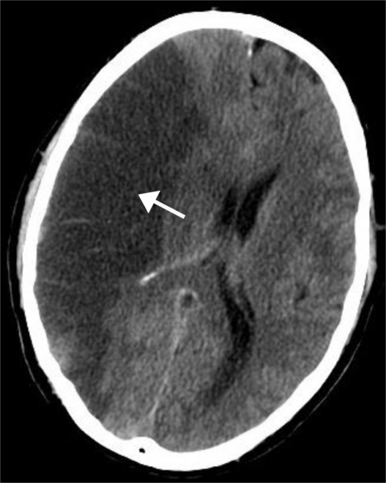
3h after occlusion
20h after occlusion

Slide 9
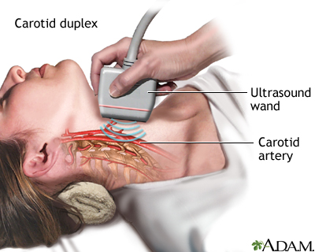

Slide 10
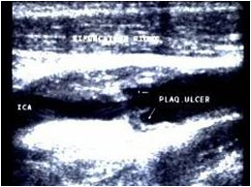
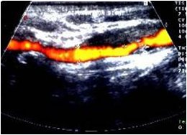
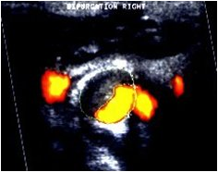
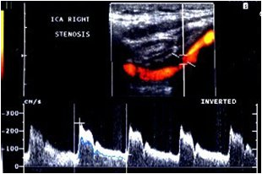
Ultrasonography with a full-duplex scan-out

Slide 11
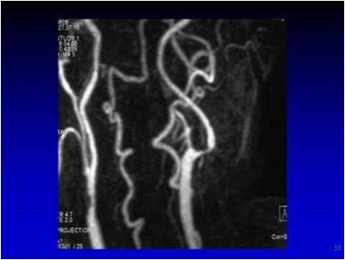
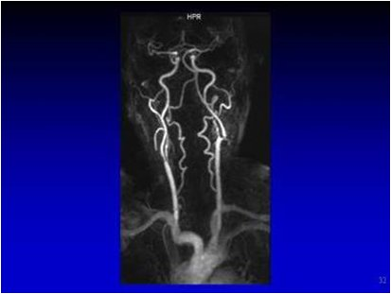
Magnetic-resonance tomography and MR-angiography

Slide 12
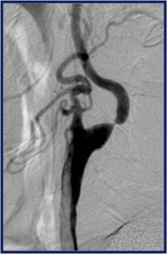
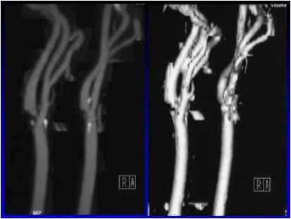
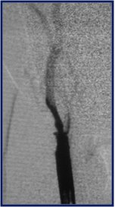
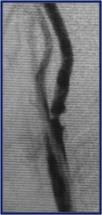
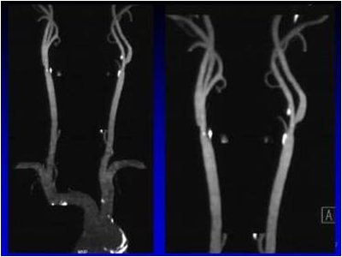
Angiography, digital angiography, 3D-CT-angiography

Slide 13
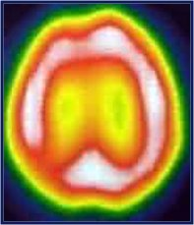
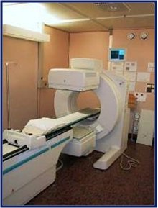
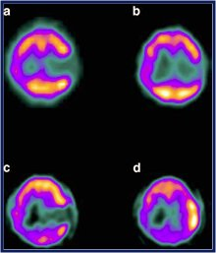
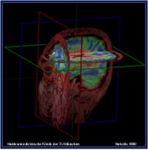
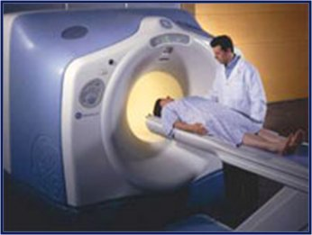
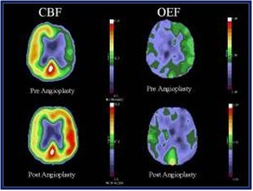
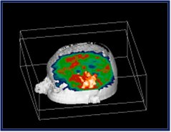
PET scan, OPECT imaging

Slide 14
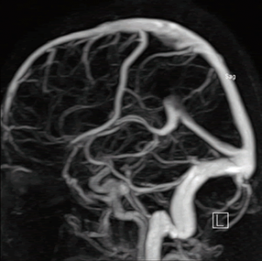
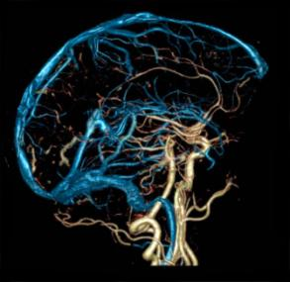
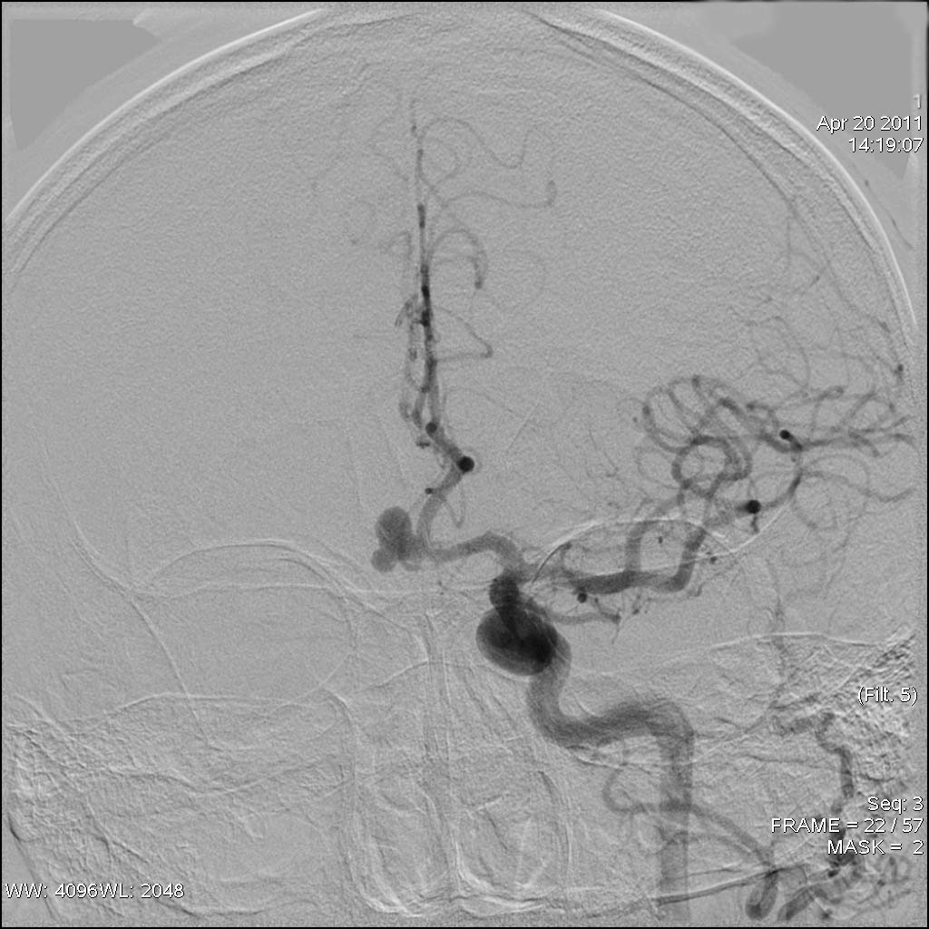
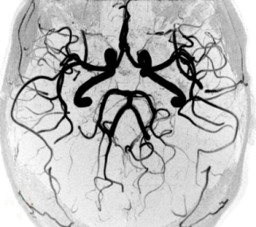
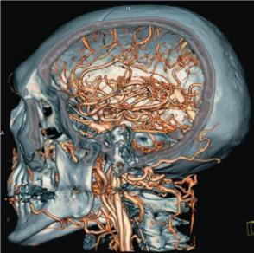
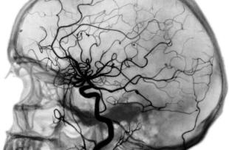
Angiography
MRI-angiography
CT-angiography
Catheter Angiography

Slide 15
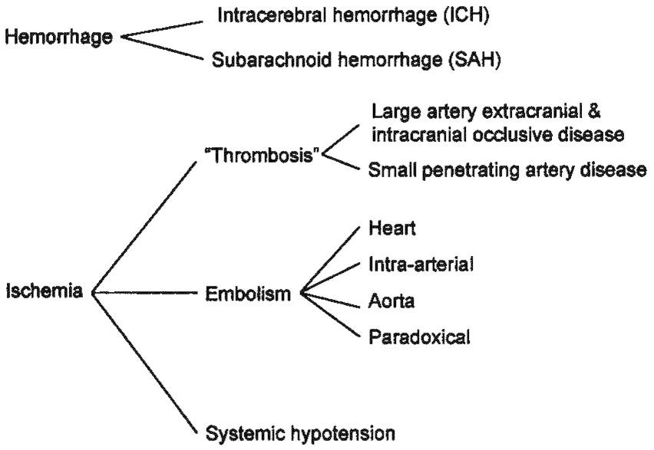
Stroke

Slide 16
Ischemic Stroke
EMBOLIC – An Ischemia Stroke that occurs
when an undissolved Solid, Liquid, or Gas
embolus blocks a cerebral artery
  Usually occurs suddenly
  Most common are clots that arise from diseased blood vessels in the neck or from abnormally contracting chambers in the heart - i.e. Atrial Fibrillation. Can also be an Air Embolus.
  May show less/more subtle deficits
  May be more sudden
  Patient may stutter as more emboli are thrown
THROMBOTIC – A blood clot that gradually develops in and obstructs cerebral artery
  Over time plaque deposits form on the inner walls of arteries (Atherosclerosis)
  Once the arteries are narrowed, platelets adhere to the rough surfaces and blood clots form blocking the blood flow through a cerebral artery
  Develops gradually – usually at night, the person awakes with altered mental status, and/or loss of speech, sensory, or motor function

Slide 17
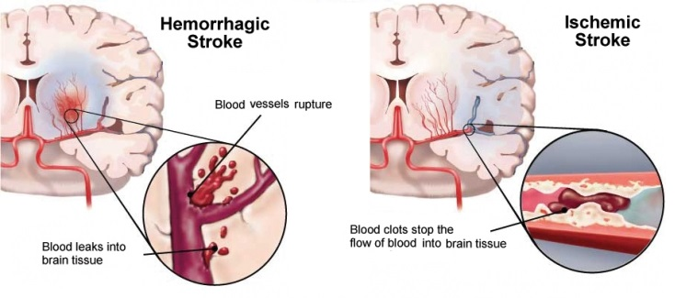
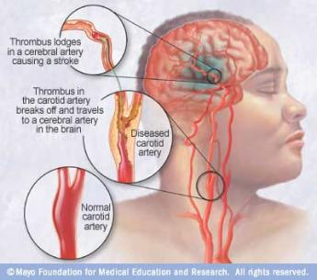
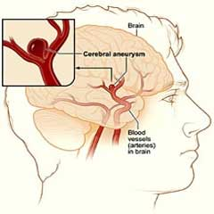
Types of Stroke

Slide 18
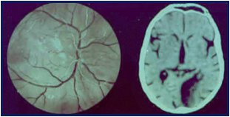
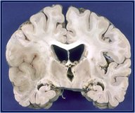
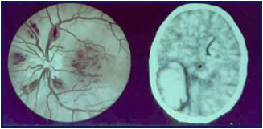
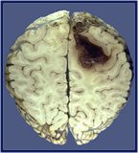
Two Types of Stroke
neurohirurg.umi.ru
Ischemic (Occlusive)
  Optic Nerve
  CT
  Autopcy
  Hemorrhagic (Bleeding)

Slide 19
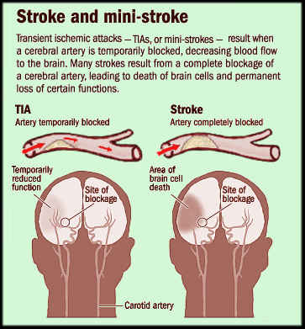
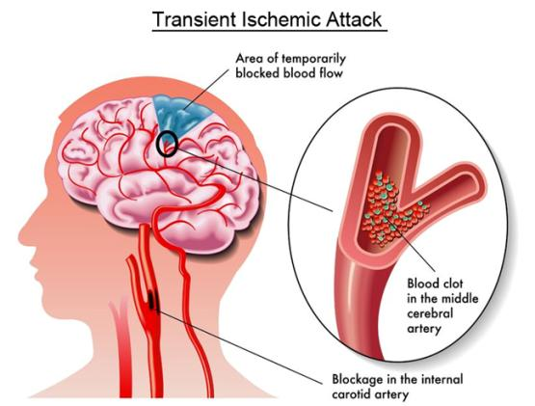
These symptoms appear and last less than 24 hours before disappearing. While TIAs generally do not cause permanent brain damage, they are a serious warning sign that a stroke may happen in the future

Slide 20
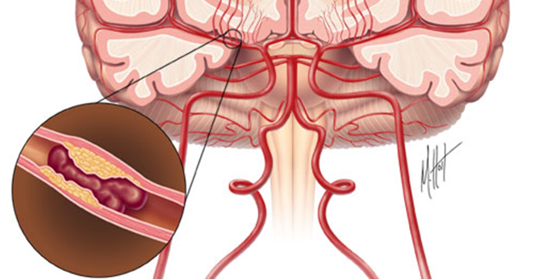
Ischemic Stroke
◊ A Stroke that occurs when a cerebral artery is blocked by a clot or other foreign matter
◊ Accounts for approximately 85% of all strokes
◊ Follows the same pattern as a heart attack
◊ Causing injury, ischemia, and
finally infarction
(tissue death)

Slide 21
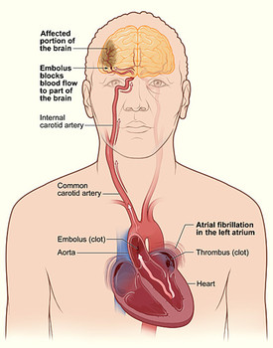
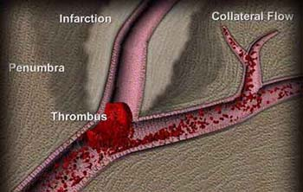
Ischemic Stroke
Most common cause: thromboembolism
Possible sources of clot:
◊ Heart
◊ Large artery (to brain)
◊ Small artery (in brain)

Slide 22
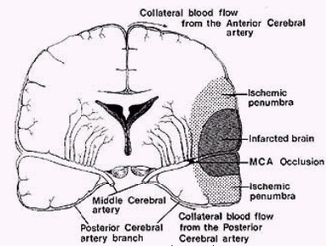
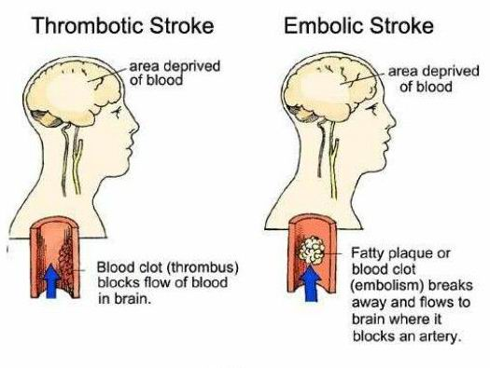
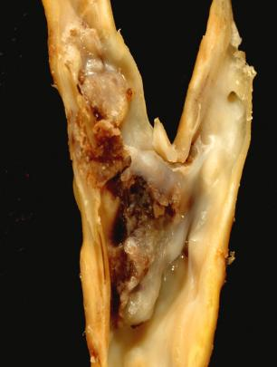
There are two types of Ischemic Stroke:
  ◊ Embolic (Embolus)
  ◊ Thrombotic (Thrombosis)

Slide 23
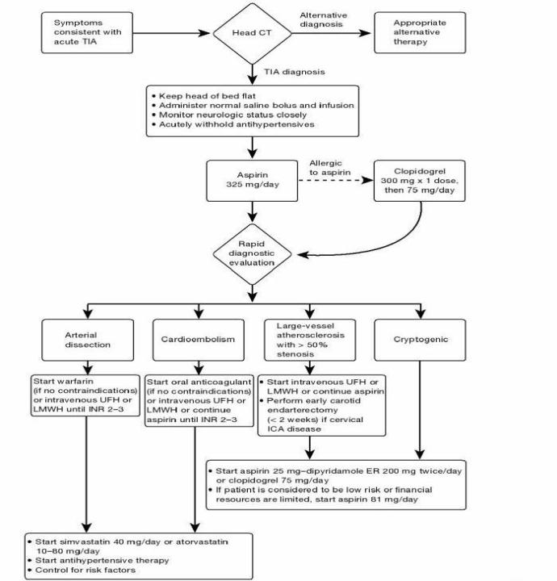

Slide 24

Cerebral Infarcts

Slide 25

Infarction in the middle cerebellar artery territory

Slide 26



Extra-Intracranial Bypass

Slide 27

Extra-Intracranial Bypass (postop)
CT-angyography

Slide 28


The methods of surgical treatment
Carotid Artery Stenting
Carotid endarterectomy is surgery to remove atheroma (plaque build up) that causes narrowing (stenosis) in the artery to lower the risk for future TIA and stroke

Slide 29





Endovascular angioplasty and stenting

Slide 30




Filters of antiembolic defence

Slide 31


Safety of Mechanical Thrombectomy and Intravenous Tissue Plasminogen Activator in Acute Ischemic Stroke

Slide 32
Hemorrhagic stroke
◊ Categorized as being a bleed within the brain (intracerebral) or in the space around the brain (subarachnoid)
◊ Onset is often sudden and marked by a severe headache
◊ Fatal in 50% to 80% of cases
◊ Most hemorrhages occur in hypertensive patients when a small vessel within the brain tissue ruptures

Slide 33

Intracerebral Hemorrhage
Most common cause:
◊ Chronic hypertension
Other causes:
◊ Vessel malformation
◊ Tumor, bleeding abnormalitie

Slide 34

Subarachnoid Hemorrhage
Most common cause:
◊ Aneurysm rupture
Other causes:
◊ Vessel malformation
◊ Tumor, bleeding abnormalities

Slide 35

Typical localisation for hematomas:
A-Subcortical
B-Putamenal
C-Thalamic
D-Pontine
E-Cerebellar

Slide 36

Putamenal hemorrhage

Slide 37

Thalamic

Slide 38

Subcortical

Slide 39

Cerebellar

Slide 40

Brainstem hemorrhage

Slide 41

Intracerebral hematoma because of right occipital lobe AVM rupture

Slide 42

Hemorrhage into metastasis of prostatic cancer

Slide 43



Death from hemorrhagic stroke
(autopsy)

Slide 44


SUBARACHNOID HEMORRHAGE

Slide 45




SUBARACHNOID HEMORRHAGE

Slide 46
Hunt & Hess Stroke Scale
For non-traumatic subarachnoid hemorrhage patients
DESCRIPTION GRADE
Asymptomatic, mild headache, slight nuchal rigidity 1
Moderate to severe headache, nuchal rigidity,
no neurologic deficit other than cranial nerve palsy 2
Drowsiness / confusion, mild focal neurologic deficit 3
Stupor, moderate-severe hemiparesis 4
Coma, decerebrate posturing 5
neurohirurg.umi.ru

Slide 47
Hospital care
Critical time periods (arrival at the hospital)
  Immediate general assessment – 10 min
  Immediately neuro assessment – 25 min
  Acquisition of a head CT – 25 min
  Interpretation of CT scan – 45 min
  Administration of IV fibrinolytics – 60 min if no bleed
  Administration of IV fibrinolytics – 3 hours from time of onset
  Administration of Interarterial fibrinolytics – 6 hours from time of onset
  Admission to a monitored bed – 3 hours

Slide 48


Aneurysms
Classification
morphology:
1. Saccular (berry)
2. Fusiform
3. Dissecting

Slide 49



Slide 50
Treatment
Concern is rebleed and treatment of vasospasm
  • Surgical clipping vs. coiling
  • Vasospasm:
      •HHH therapy
      •Angioplasty
      •Peak day 7-10 (3-21)
neurohirurg.umi.ru

Slide 51


Surgical Clipping of Aneurysm

Slide 52





Slide 53

Surgery cerebral aneurysm

Slide 54

Surgery cerebral aneurysm

Slide 55

Surgery cerebral aneurysm

Slide 56


Slide 57


Slide 58


Slide 59

Surgical Clipping of Aneurysm

Slide 60


Surgical Clipping of Aneurysm

Slide 61

Endovascular technique

Slide 62


Detachable platinum coil

Slide 63


Inserting coil

Slide 64




Coiling principle

Slide 65




Stent Assisted Coiling

Slide 66


Coiling of Aneurysm

Slide 67


Multiple saccular AA of basilar artery bifurcation

Slide 68


Turning off the saccular aneurysm of the basilar artery blood flow with platinum coils

Slide 69

Saccular aneurysm of the anterior communicating artery on the left

Slide 70


After surgery, aneurysm from blood flow detachable coils

Slide 71

Giant saccular posterior communicating artery aneurysm

Slide 72


After surgery, aneurysm from blood flow detachable coils

Slide 73


Мешотчатая аневризма супраклиноидного отдела внутренней сонной артерии слева
postop
before

Slide 74

Saccular aneurysm of the left perikallosis artery

Slide 75


After embolization of the left artery perikallosis aneurysm

Slide 76


Saccular aneurysm of the posterior cerebral артерии слева
postop
before

Slide 77


CT-angiography saccular aneurysm segment M1-M2 left MCA

Slide 78

Selective angiography of saccular aneurysm of the M1-M2 segment of the left MCA

Slide 79

Condition after total saccular aneurysm embolization M1-M2 segment left MCA

Slide 80

Carotid cavernous fistula

Slide 81


Slide 82



Notes:
82
Ophthalmoplegia v common 2o EOM nerve damage. 6th CN in 50%, with variable 3 n 4. Engorgement of EOMs contributes. FE-venous engorgement n tortuosity, occ CRVO. Dec VA common n may be perm.

Slide 83




Carotid cavernous fistula treatment

Slide 84


Slide 85


Carotid cavernous fistula
preop
postop

Slide 86


Carotid cavernous fistula
preop
postop

Slide 87

ДИНАМИКА ХЕМОЗА ПОСЛЕ ОПЕРАЦИИ
preop
5d posop
2w postop

Slide 88




Arteriovenous Malformations (AVM)
An abnormal collection of blood
vessels wherein arterial blood
flows directly into draining veins
without brain parenchyma in the
nidus

Slide 89


АВМ правой теменной доли
МРТ режим Т1
МРТ режим Т2

Slide 90


Прежнее наблюдение
МРТ Flair
МРТ-ангиография

Slide 91

АВМ стволовых отделов

Slide 92

Множественные АВМ

Slide 93

АВМ
височной
области
СКТ головного мозга
МРТ головного мозга

Slide 94

Прежнее наблюдение
КАГ прямая проекция
КАГ боковая проекция

Slide 95

Варианты АВМ
А) Артериальная
В) Артериовенозная фистулезная
С) Артериовенозная рацемозная (75%)
D) Артериовенозная микромальформация
Е) Артериовенозная кавернозная (11%)
F) Телеангиоэктазия
G) Венозная

Slide 96

Spetzler-Martin (1986)

Slide 97


Slide 98


Slide 99


Slide 100


Slide 101


Slide 102


Localization AVM

Slide 103



Эндоваскулярное выключение артериовенозных мальформаций сосудов головного мозга с использоваием клея для артериальных сосудов ПВА (поли-винил-алкоголь кополимер)

Slide 104



Surgery AVM

Slide 105



Slide 106


Endovascular embolization AVM

Slide 107


Артериовенозная мальформация в бассейне правой задней мозговой артерии
До операции
После операции

Slide 108


Артериовенозная мальформация теменно-затылочной области слева
До операции
После операции

Slide 109

Артериовенозная мальформация кончика носа бассейна правой наружной сонной артерии

Slide 110

Промежуточный этап эмболизации АВМ носа бассейна правой наружной сонной артерии

Slide 111

Тотальная эмболизации АВМ кончика носа бассейна правой наружной сонной артерии

Slide 112


Клинический пример: операция при АВМ теменной доли
Первичная ангиография
Полная окклюзия АВМ

Slide 113


АВМ мозолистого тела справа до эмболизации
Боковая проекция
Полуаксиальная проекция

Slide 114


АВМ мозолистого тела справа после эмболизации
Боковая проекция
Полуаксиальная проекция

Slide 115


Спинальные мальформации

Slide 116

Спинальная АВМ на уровне С2-С4 позвонков

Slide 117

Состояние после эндоваскулярной эмболизации спинальной АВМ на уровне С2-С4 позвонков

Slide 118

THANK YOU!

